Slide 1


James, Friday Emmanuel
October, 2022

Slide 2

Outline
Executive Summary
Introduction
Methodology
Insights Drawn From Exploratory Data Analysis
Launch Sites Proximities
Dashboard
Predictive Analytics
Results
Conclusion
Appendix

Slide 3
Executive Summary
Problem Definition
CBS news has it that the most competitive businesses are those that effectively transform data relating to competitors into decision-relevant insights. Also, understanding a competitor will be easier if we develop a keen sense of market awareness and product quality.
SpaceX designs, manufactures and launches rockets and spacecrafts and dominate the market because of the reusability of its rockets. However, not all rockets launched land successfully. The problem is how we can leverage this unsuccessful landing and develop methodologies to predict if a rocket would land successfully or not.
Significance
The machine learning models would enable our company, SpaceY to determine the success of rocket landing. This is particularly significant as a failed landing could lead to huge financial losses. The prediction would help the cost analysis and make better offers than SpaceX.
Method Used:
We collected data on SpaceX’s Falcon 9 rocket launches and used it to train Machine Learning models that will predict whether the first stage of the rocket will land successfully. This was done through the following ways:
Harvesting data on SpaceX’s Falcon 9 rocket launches using API requests and Web Scraping
Exploratory Data Analysis
Building predictive models using machine learning algorithms

Slide 4
Introduction
SpaceX advertises Falcon 9 rocket launches on its website, with a cost of 62 million dollars. Other providers cost upward of 165 million dollars each, much of the savings is because SpaceX can reuse the first stage. However, not all of its launches land successfully.
The objective of this project is to allow our company, SpaceY to compete with SpaceX. In order to achieve this goal, it is necessary to predict if the first stage of the SpaceX Falcon 9 rocket will land successfully.
Ultimately, an accurate prediction of the likelihood of the first stage rocket landing successfully will help us to determine the cost of a launch. With the help of the Exploratory Data Analysis and predictive models, we can make more informed decisions and compete with SpaceX.

Slide 5

Section 1

Slide 6
Methodology
Executive Summary
Data collection methodology:
Make requests to the SpaceX API.
Perform web scraping to collect Falcon 9 historical launch records on the Wikipedia page titled: List of Falcon 9 and Falcon Heavy launches
Perform data wrangling
This involves cleaning the data and removing unwanted features in order to make the data fit for modeling
Perform exploratory data analysis (EDA) using visualization and SQL
Perform interactive visual analytics using Python’s Folium, Plotly and Dash Libraries.
Perform predictive analysis using classification models
We build Machine Learning classification algorithms to determine whether the first state of the Falcon 9 rocket launch would land successfully or not.
We use different hyperparameters to in Grid Search to train the best model and determine its accuracy.

Slide 7
Data Collection
Having defined the objective and significance of the project, we now have a clear direction of the nature and method(s) of collecting the relevant data viz:
Making an Application Program Interface (API) request to SpaceX
Scraping SpaceX data from their website data repository

Slide 8
Data Collection – SpaceX API
Make request to SpaceX API
Decode the response content as a Json
Turn Json into pandas data frame
Use the API again to get information about the launches using the IDs given for each launch
Construct our dataset using the data we have obtained
Filter the dataframe to only include Falcon 9 launches
Replace null values in the data with the mean that was calculated
Save the data as a csv file
Make a request to SpaceX API
Perform data wrangling, dealing with missing data and putting data in proper format.
Lastly, save the data as a csv file
URL link: https://github.com/Friday-J/SpaceX_Falcon-9_Rocket_Landing_Prediction/blob/main/SpaceX-data-collection-api.ipynb

Slide 9
Data Collection - Scraping
Using BeautifulSoup Python library, we perform web scraping on the wikipedia page with title: List of Falcon 9 and Falcon Heavy launches
Store the launch records in an HTML table.
Parse the table, save the data as a csv file
URL link: https://github.com/Friday-J/SpaceX_Falcon-9_Rocket_Landing_Prediction/blob/main/SpaceX-data-collection-web-scraping.ipynb
Request the Falcon9 Launch Wiki page from its URL
Create a BeautifulSoup object from the HTML respone
Extract all column/variable names from the HTML table header
Create an empty dictionary with keys from the extracted column names
Fill up the dictionary with launch records extracted from table rows.
Convert the dictionary into a CSV dataset

Slide 10
Data Wrangling
The data is cleaned, and null values replaced with the mean of the respective columns.
We notice several instances where the rocket did not land successfully. For example, True RTLS means the rocket successfully landed on a ground pad while False RTLS means the rocket unsuccessfully landed on a ground pad.
Those outcomes were converted into Training Labels whereby 1 means the rocket landed successfully while 0 means it was unsuccessful.
URL link: https://github.com/Friday-J/SpaceX_Falcon-9_Rocket_Landing_Prediction/blob/main/Spacex_Data%20wrangling.ipynb
Determine the number of launches on each facility
Calculate the number and occurrences of each orbit
Calculate the number and occurrences of mission outcome per orbit type
Create a "Class" column containing the information from the outcome label
Transform the data frame into a CSV dataset.
Create a landing outcome training label and loop through all the landing outcomes

Slide 11
EDA with Data Visualization
Exploratory Data Analysis through visualizations depicts the distribution of the data, identifies any outliers and patterns in the data. It also explores the relationship between the features and the target label. Here, we used:
Cat plots and scatter plots to view the relationships of categorical variables like Launch Site and Orbit.
A bar chart was used to visualize the success rate of each orbit type.
A line chart was used to visualize the launch success yearly trend.
URL link: https://github.com/Friday-J/SpaceX_Falcon-9_Rocket_Landing_Prediction/blob/main/Exploratory_Data_Analysis_with_Matplotlib_Pandas.ipynb

Slide 12
EDA with SQL
Summary of SQL queries that were used:
Display the names of the unique launch sites in the space mission
Compare the payload mass with boosters launched by NASA (CRS)
Display average payload mass carried by booster version F9 v1.1
List the total number of successful and failure mission outcomes
Determine the dates of different landing outcomes
URL link: https://github.com/Friday-J/SpaceX_Falcon-9_Rocket_Landing_Prediction/blob/main/Exploratory_Data_Analysis_with_SQL.ipynb

Slide 13
Build an Interactive Map with Folium
Folium Circles were used to highlight circle area of launch sites.
Folium Markers were used to show the SpaceX launch sites and their nearest important landmarks like railways, highways, cities and coastlines.
Polylines were used to connect the launch sites to their nearest land marks.
In order to mark the success/failed launches for each site, marker clusters were used on the map. Whereby Red represents rocket launch failures while Green represents the successes.
URL link: https://github.com/Friday-J/SpaceX_Falcon-9_Rocket_Landing_Prediction/blob/main/Launch%20Site%20Location.ipynb

Slide 14
Build a Dashboard with Plotly Dash
Pie charts and scatter charts were used to visualize the launch records of SpaceX.
The plots and interactions give us insight as to the rocket launch success rate per launch site and mass of the payload.
Successful launches were represented by 1 while failures were represented by 0.
URL link: https://github.com/Friday-J/SpaceX_Falcon-9_Rocket_Landing_Prediction/blob/main/Building%20Interactive%20Dashboards.ipynb

Slide 15
Predictive Analysis (Classification)
Create a column for the class
Standardize the data
Split data into training data and test data
Create a GridSearchCV object and fit different ML objects.
Calculate the accuracy on the test data
Choose the best ML method
Compare the predictions with the real labels
Python’s Machine Learning library Scikit-learn is for the predictive analysis. We used it to:
Build a machine learning pipeline to predict whether the first stage will land successfully
Using GridSearchCV, found the best parameters for each classification algorithm
Apply the model on the test data to get accuracy scores for each model.
URL link: https://github.com/Friday-J/SpaceX_Falcon-9_Rocket_Landing_Prediction/blob/main/SpaceX_Machine%20Learning%20Predictions.ipynb

Slide 16
Results
The EDA shows that:
Strong correlation between the landing outcome and the flight number.
Payload mass in kg is inversely correlated with the landing outcomes
It was also apparent that successful landing outcomes have had a significant increase since the year 2015.
Spatial visualizations show that:
All launch sites are located near the coastline
The launch sites are also located near highways and railways.
The machine learning algorithms classifies rockets as successfully/unsuccessfully landing with an accuracy of 83.33%.

Slide 17

Section 2

Slide 18
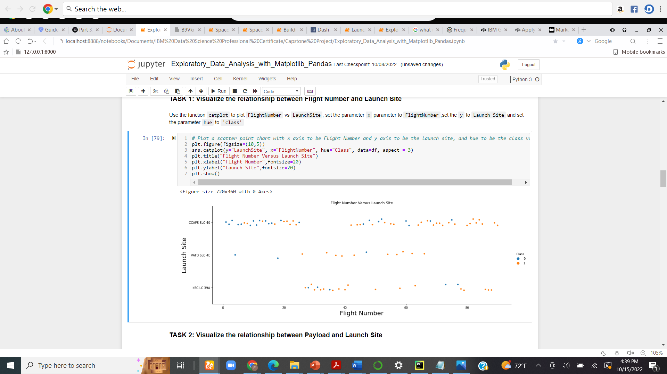
Flight Number vs. Launch Site
The visualization depicts that the flight number is directly proportional to the number of successful landings.
The launch site CCAFS SLC 40 had the most number of landing attempts while the site VAFB SLC 4E had the least number of attempts.

Slide 19
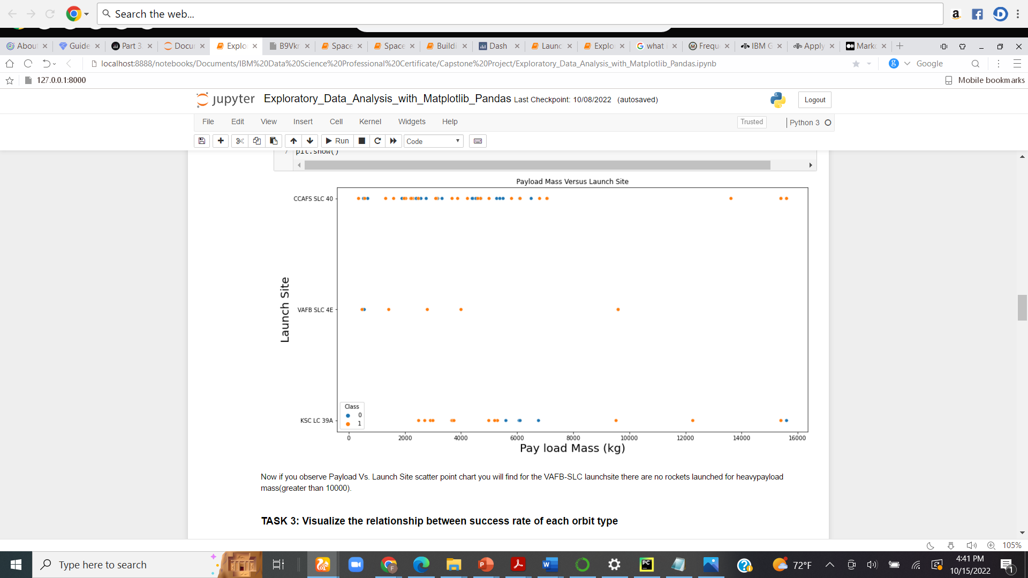
Payload vs. Launch Site
The launch sites are sensitive to the mass of the payload in that rockets with payload mass greater than 10000kg are most unlikely to be launched at the sites.

Slide 20
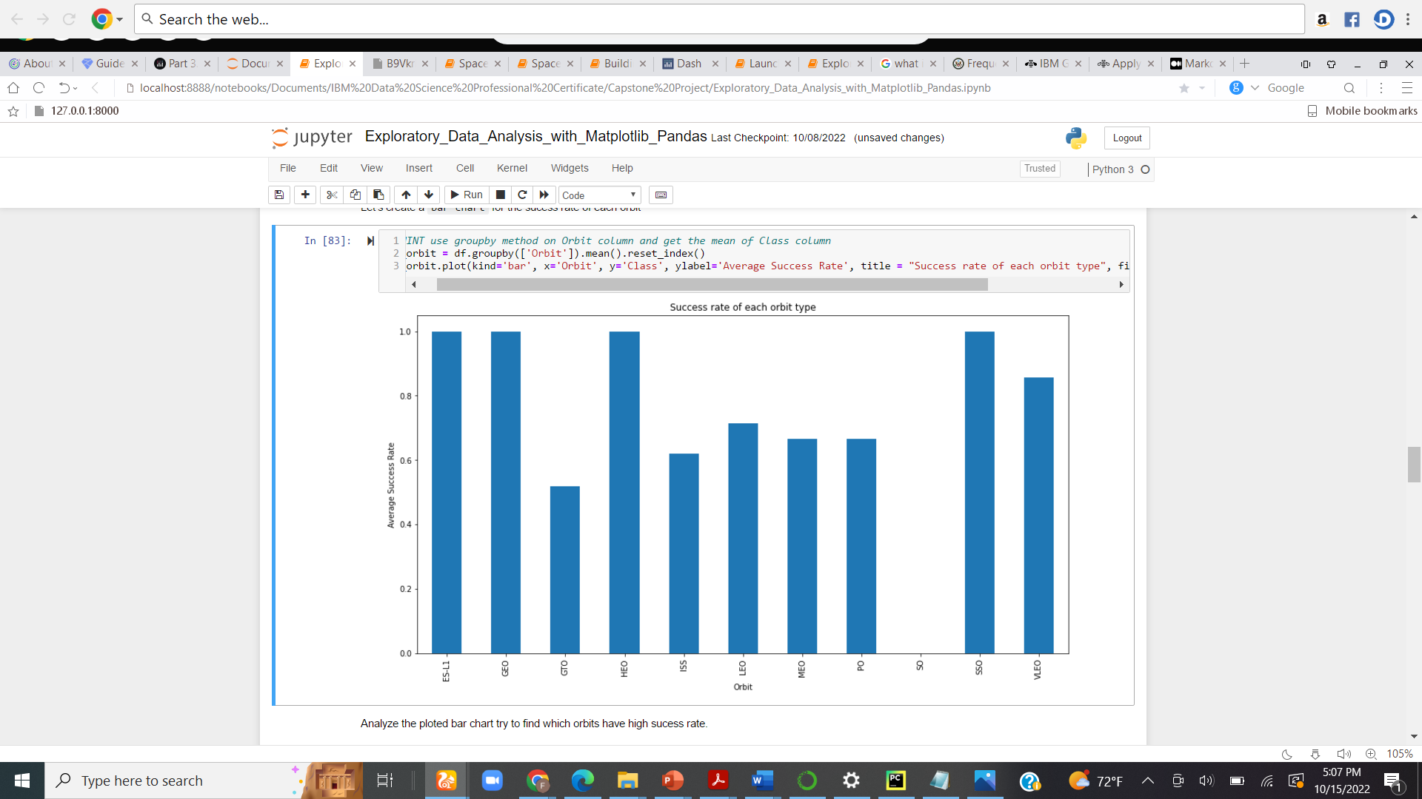
Success Rate vs. Orbit Type
Four (4) of the Orbits (ESL1, GEO, HEO and SSO) records the most success rate on the average. This should be a crucial factor to consider when launching a rocket

Slide 21
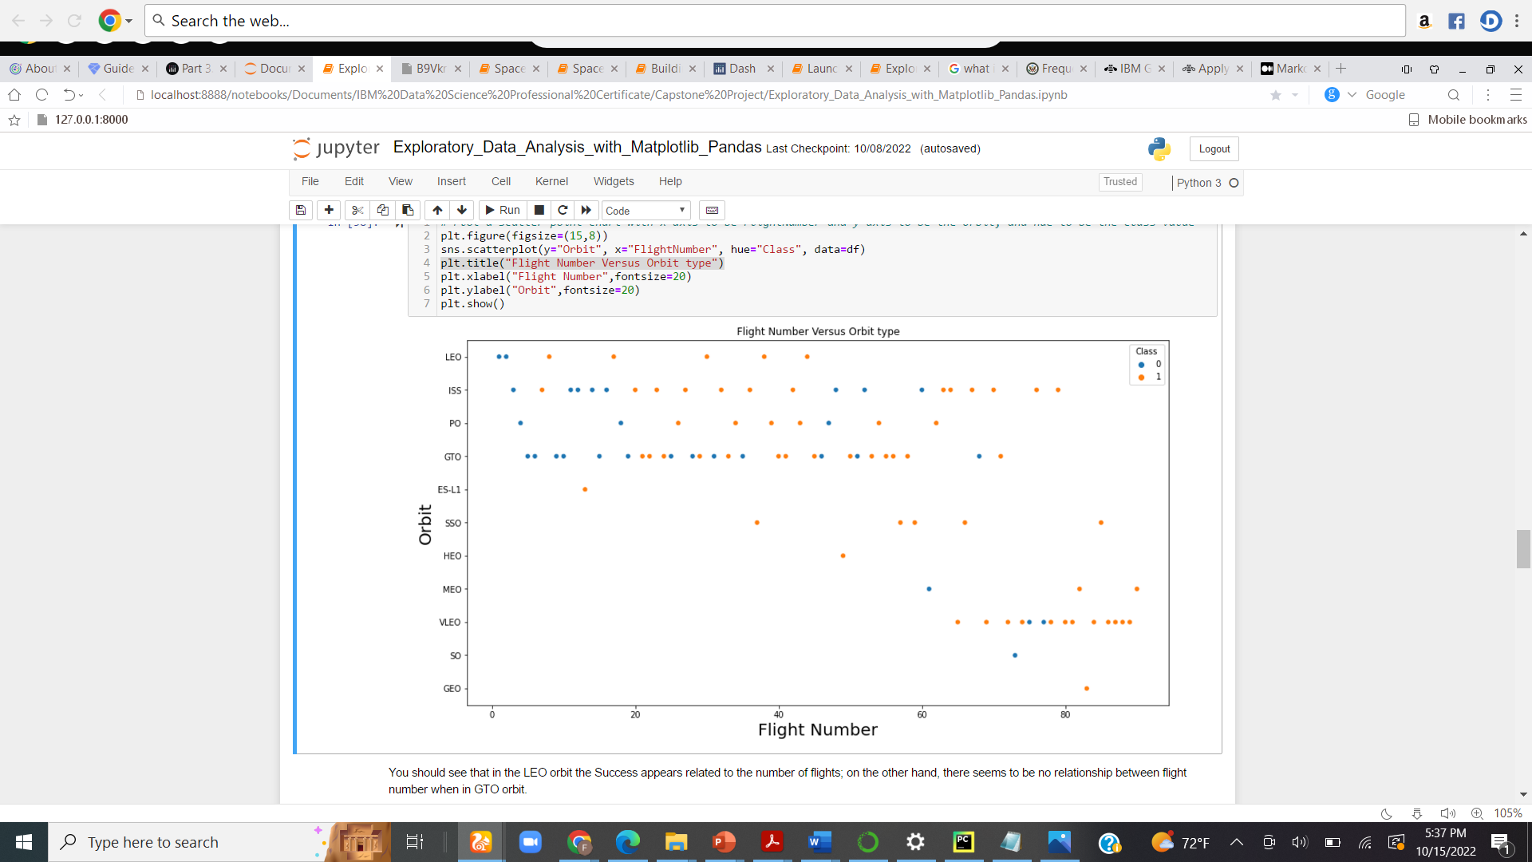
Flight Number vs. Orbit Type
LEO, SSO and VLEO appears to have strong correlation with the flight number in recording landing successes.

Slide 22
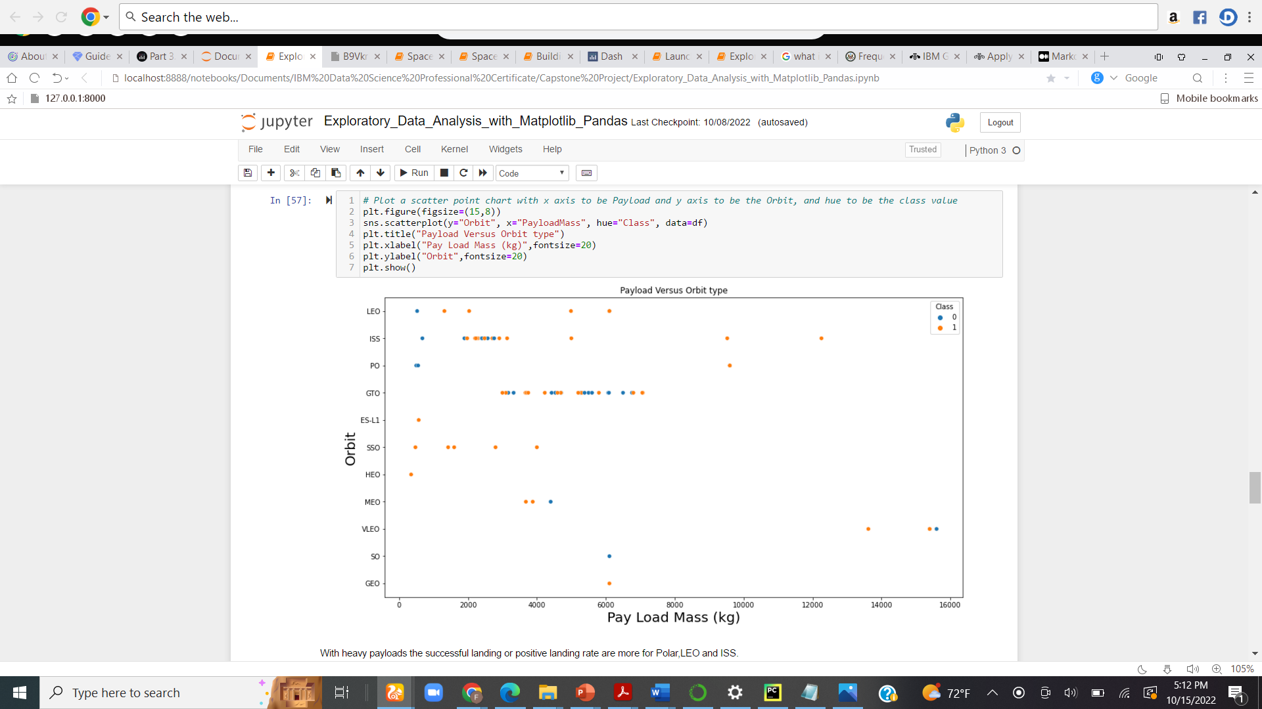
Payload vs. Orbit Type
There are more successful launches for LEO and SSO Orbits when the payload mass is relatively small compared to GTO and ISS where the effect of the payload mass is not easily noticeable. GEO, ESL1 and GEO all had successful landing with low payload masses.

Slide 23
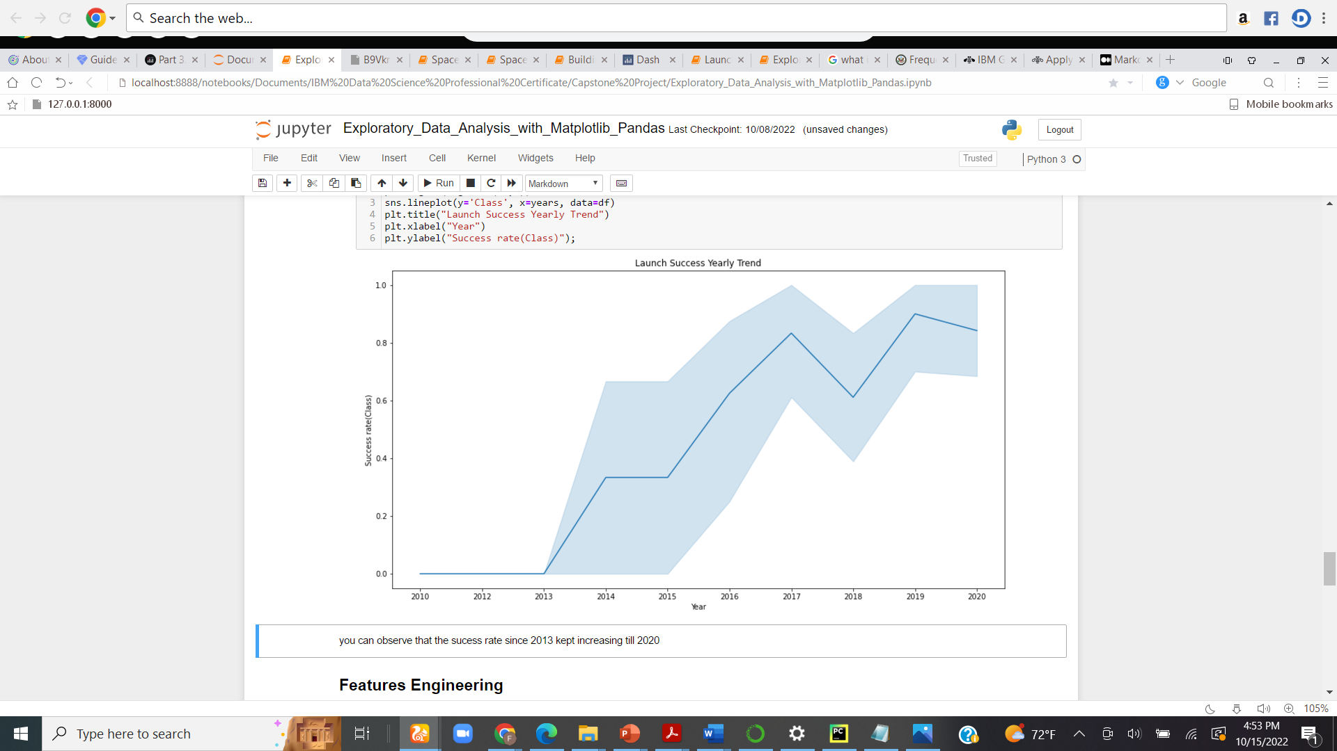
Launch Success Yearly Trend
There has been a successful launch of the SpaceX Falcon 9 rocket from 2013. Albeit there was a slight decline in 2018 but the trend goes upward thereafter

Slide 24
All Launch Site Names
There are four (4) distinct launch sites gathered from the data viz:
CCAFS LC-40
CCAFS SLC-40
KSC LC-39A
VAFB SLC-4E

Slide 25
Launch Site Names Begin with 'CCA'
Result for 5 launch sites that begin with ‘CCA’ shows that NASA also launched their rockets on these sites.
Date | Launch_Site | Orbit | PayloadMass (Kg) | Customer | Mission_Outcome | Landing_Outcome
04-06-2010 | CCAFS LC-40 | LEO | 0 | SpaceX | Success | Failure (parachute)
08-12-2010 | CCAFS LC-40 | LEO (ISS) | 0 | NASA (COTS) NRO | Success | Failure (parachute)
22-05-2012 | CCAFS LC-40 | LEO (ISS) | 525 | NASA (COTS) | Success | No attempt
08-10-2012 | CCAFS LC-40 | LEO (ISS) | 500 | NASA (CRS) | Success | No attempt
01-03-2013 | CCAFS LC-40 | LEO (ISS) | 677 | NASA (CRS) | Success | No attempt

Slide 26
Total Payload Mass
Total payload mass carried by boosters launched by NASA .
NASA (CRS) had a relatively high total payload mass than the other NASA customers
Customer | Total_Payload_Mass
NASA (CRS) | 45596
NASA (CCDev) | 12530
NASA (CCP) | 12500
NASA (CCD) | 12055
NASA (CTS) | 12050
NASA (CRS), Kacific 1 | 2617
NASA / NOAA / ESA / EUMETSAT | 1192
NASA (LSP) NOAA CNES | 553
NASA (COTS) | 525
NASA (LSP) | 362
NASA (COTS) NRO | 0

Slide 27
Average Payload Mass by F9 v1.1
The average payload mass carried by F9 v1.1 was 2928.4 kg.
Average_Payload_Mass (kg) | Booster_Version
2928.4 | F9 v1.1

Slide 28
First Successful Ground Landing Date
Date of the first successful landing outcome on ground pad was December 22, 2015
Date | Landing_Outcome
22-12-2015 | Success (ground pad)

Slide 29
Successful Drone Ship Landing with Payload between 4000 and 6000
Names of boosters which have successfully landed on drone ship and had payload mass greater than 4000 but less than 6000
This confirms that low payload mass have a positive impact on the landing outcome
Booster_Version | PAYLOAD_MASS__KG_ | Landing_Outcome
F9 FT B1022 | 4696 | Success (drone ship)
F9 FT B1026 | 4600 | Success (drone ship)
F9 FT B1021.2 | 5300 | Success (drone ship)
F9 FT B1031.2 | 5200 | Success (drone ship)

Slide 30
Total Number of Successful and Failure Mission Outcomes
Total number of successful and failure mission outcomes
Mission_Outcome | Outcomes
Failure (in flight) | 1
Success | 99
Success (payload status unclear) | 1

Slide 31
Boosters Carried Maximum Payload
Twelve (12) Boosters carried the maximum payload and all from the same manufacturers.
Booster_Version | PAYLOAD_MASS__KG_
F9 B5 B1048.4 | 15600
F9 B5 B1049.4 | 15600
F9 B5 B1051.3 | 15600
F9 B5 B1056.4 | 15600
F9 B5 B1048.5 | 15600
F9 B5 B1051.4 | 15600
F9 B5 B1049.5 | 15600
F9 B5 B1060.2 | 15600
F9 B5 B1058.3 | 15600
F9 B5 B1051.6 | 15600
F9 B5 B1060.3 | 15600
F9 B5 B1049.7 | 15600

Slide 32
2015 Launch Records
In the months of January and April of the year 2015, two versions of the F9 v1.1 rockets failed to land successfully at the CCAFS LC-40 site.
Date | Launch_Site | Booster_Version | Landing_Outcome
10-01-2015 | CCAFS LC-40 | F9 v1.1 B1012 | Failure (drone ship)
14-04-2015 | CCAFS LC-40 | F9 v1.1 B1015 | Failure (drone ship)

Slide 33
Rank Landing Outcomes Between 2010-06-04 and 2017-03-20
Ranking the count of landing outcomes between the date 2010-06-04 and 2017-03-20 shows an increase in successful landing from 2015
_date_ | Landing_Outcome | Outcomes
2016-04-08 | Success (drone ship) | 14
2015-12-22 | Success (ground pad) | 9
2015-06-28 | Precluded (drone ship) | 1
2015-01-10 | Failure (drone ship) | 5
2014-04-18 | Controlled (ocean) | 5
2013-09-29 | Uncontrolled (ocean) | 2
2012-05-22 | No attempt | 22

Slide 34

Section 3

Slide 35
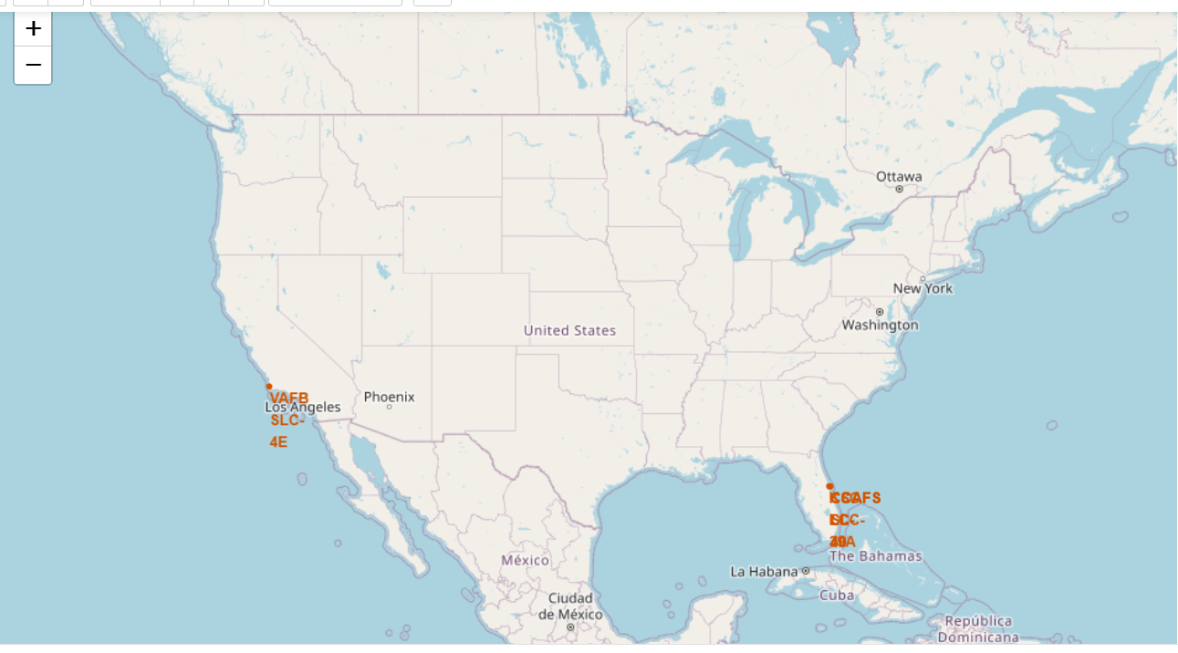
Launch Site Locations
Majority of the launch sites are around the coastal regions of Florida

Slide 36
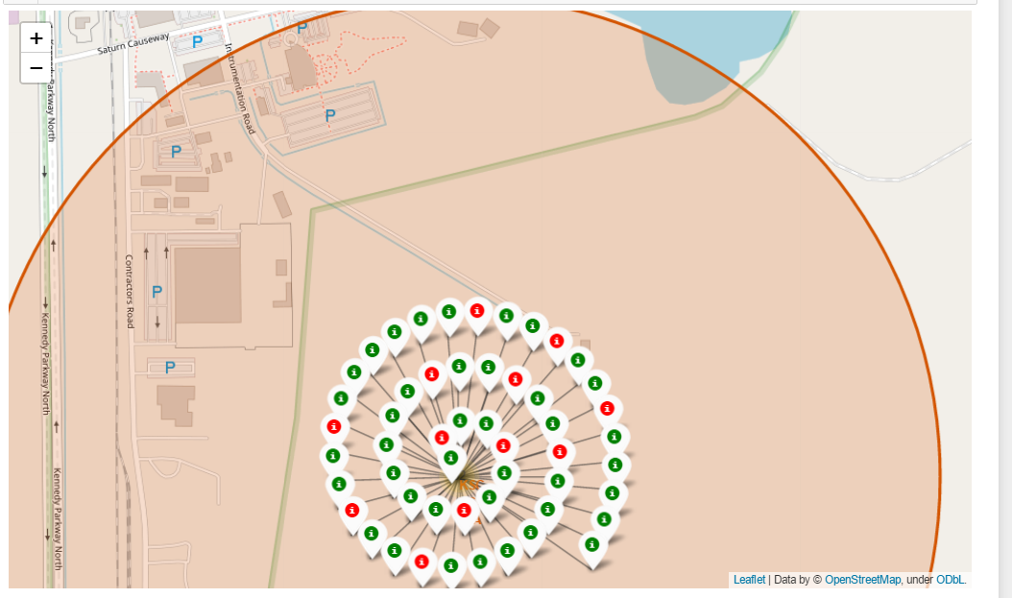
Success Rate by Launch Sites
The figure below shows the success rate distribution at the KSC LC-39A launch site which happens to have the most successful landing outcomes compared to other launch sites.
The successful launches are represented by a green marker while the red marker represents failed rocket launches.

Slide 37
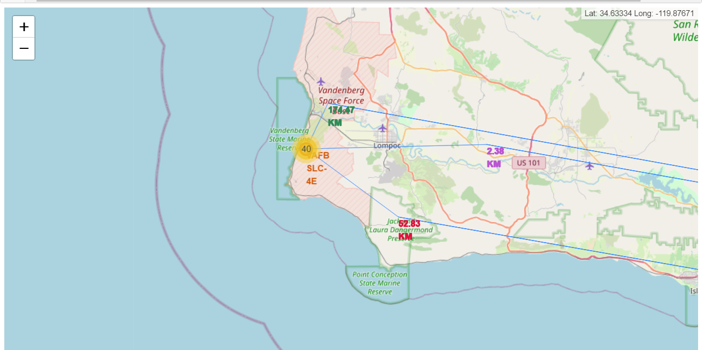
Launch Site Proximities
Launch sites are far away from metropolitan cities in order to avoid damages to human and materials
They are also close to the coastlines as it is more appropriate to test the rocket landing on large water masses

Slide 38

Section 4

Slide 39
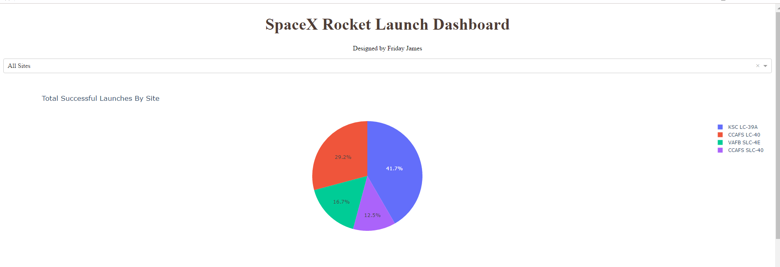
Launch Success Count for All Sites
Displaying the distribution of the total successful launches by sites.
Site KSC LC-39A has the most successful launch compared to the rest launch sites

Slide 40
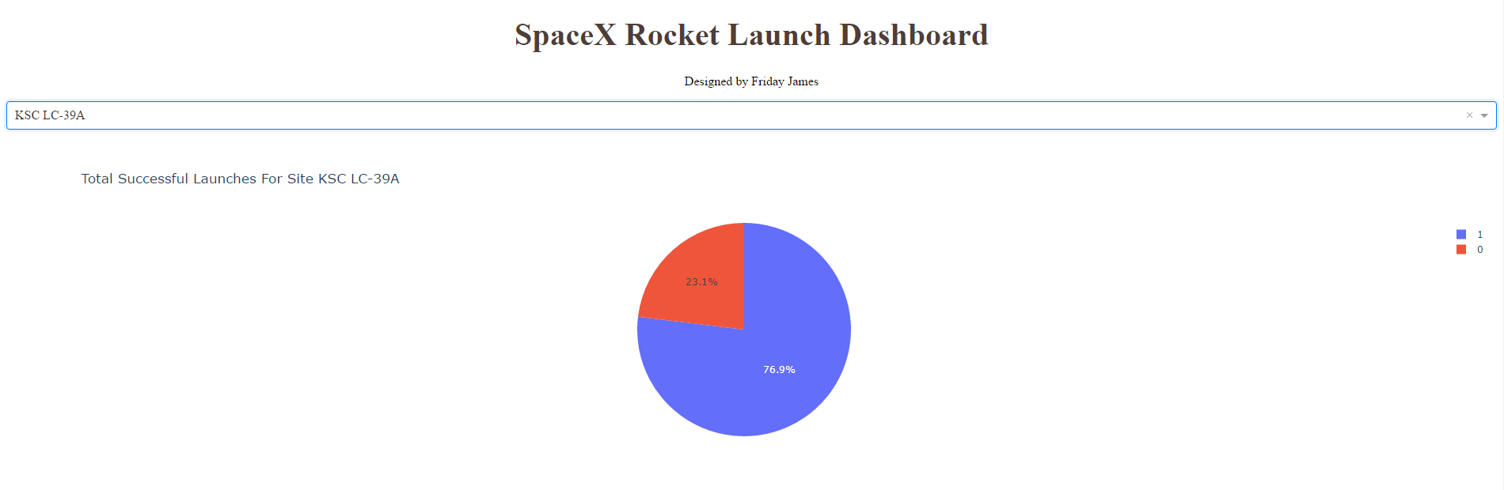
Highest Launch Success Ratio
Site KSC LC-39A has the most successful launch compared to the rest launch sites

Slide 41
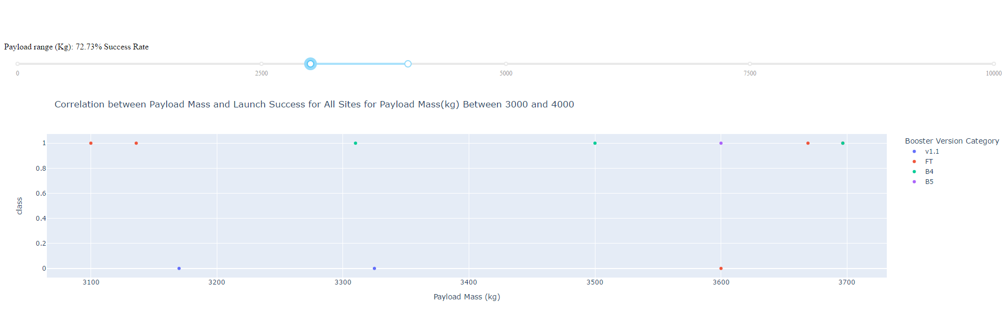
Launch Outcome With Respect to Payload
A payload range between 3000 kg and 4000 kg has the highest success rate (approximately 72.73%).
The booster version FT, seems to have a higher success rate than other booster versions

Slide 42

Section 5

Slide 43
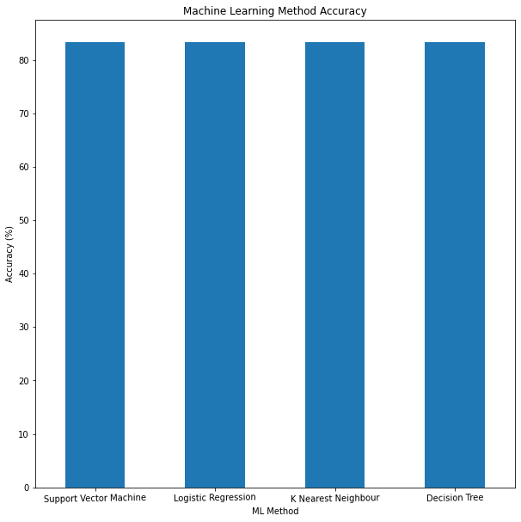
Classification Accuracy
Each machine learning algorithm has equal accuracy score of 83.33%.

Slide 44
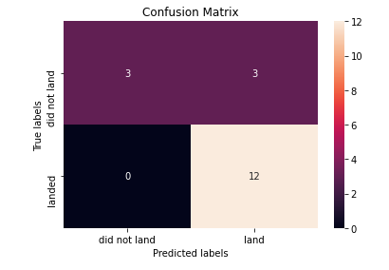
Confusion Matrix
The chart shows the confusion matrix of the Decision Tree
The model only failed to accurately predict 3 labels.

Slide 45
Conclusions
From the Exploratory Data Analysis and interactive visualizations on the SpaceX dataset, the following conclusions can be drawn with respect to the landing outcomes and relationships among the features that determine the landing outcomes of the Falcon 9 rocket
Payload mass (in kg) is inversely correlated with the landing outcomes. The higher the mass of the payload, the less successful it is for the rocket to land successfully
Site KSC LC-39A had the highest launch success rate out of all the launch sites.
Most of the launch sites are located close to the coastlines and far away from metropolitan cities.
It was also apparent that successful landing outcomes had an upward trend since the year 2015
There is a possibility to predict whether a rocket launch would be successful or not with an 83.33% accuracy.
With these, our company, SpaceY would be able to compete with SpaceX since we can channel resources to rockets with less payload mass, target the KSC LC-39A and increase the flight number.

Slide 46
Appendix
The Python codes used for this project can be found in my GitHub repository at:
https://github.com/Friday-J/SpaceX_Falcon-9_Rocket_Landing_Prediction

Slide 47


